Slide 1
TOMORROW’S TB TREATMENT IN CHILDREN
Anneke C. Hesseling
Desmond Tutu TB Centre
Stellenbosch University
31 October 2014

Slide 2

Key transitions in tuberculosis
Susceptible
Exposed
Each transition has a measurable probability
Infected
Diseased
Infectious
Sick
Accessed care
Recognized
Diagnosed
Treated
Completed
Cured
Mortality
Don Enarson, The Union

Slide 3
Research Area | Gaps for children | Priority studies
DS-TB | PK/safety first-line drugs at higher doses, esp. infants, HIV+ Optimal treatment for TB meningitis Treatment shortening DS-TB | PK studies first-line drugs at higher doses PK/efficacy study in children SHINE, nested PK
DR-TB | PK/dosing second-line drugs (FQ, aminoglycosides, linezolid) Injectable sparing shorter regimen New drug PK and safety (bedaquiline, delamanid, PA-824, sutezolid) | Modeling existing data, testing doses predicted to achieve PK targets Non-inferiority trial PK/safety studies bedaquiline, PA-824, DLM, BDQ and combinations
Co-treatment TB/HIV | Super boosting LPV/r in young children taking HRZE EFV-based regimen in children < 3 years INSTI-based ART with standard TB drugs (HRZE) | Super-boosted PI with HRZE EFV+HRZE in slow CYP2B6 genotype RAL or DTG-based ART with TB drugs
LTBI | Safety/tolerability/PK once-weekly INH/RPT regimen for youngest children DDI with ART MDR LTBI | RPT dose for children under 2 for weekly INH/RPT; tolerability/bioequivalence child-friendly formulation Efficacy and safety of long-term use of fluoroquinolones

Slide 4
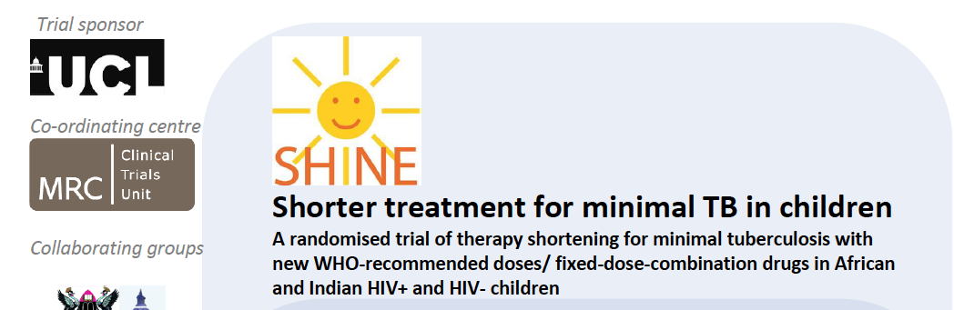

PI: Gibb, BMRC CTU

Slide 5
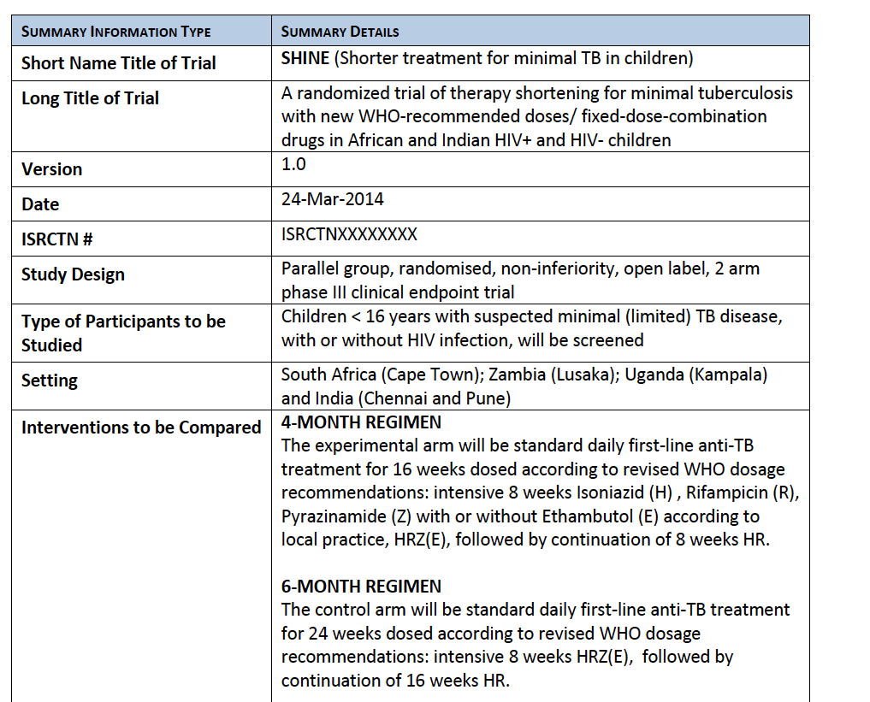

Slide 6
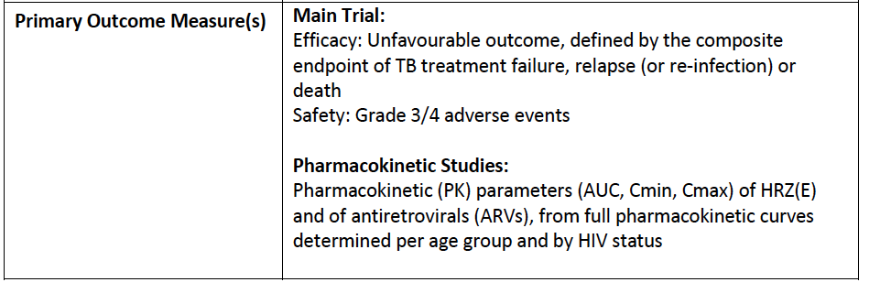
N=1200 children
New FDC; 75, 50, 150

Slide 7
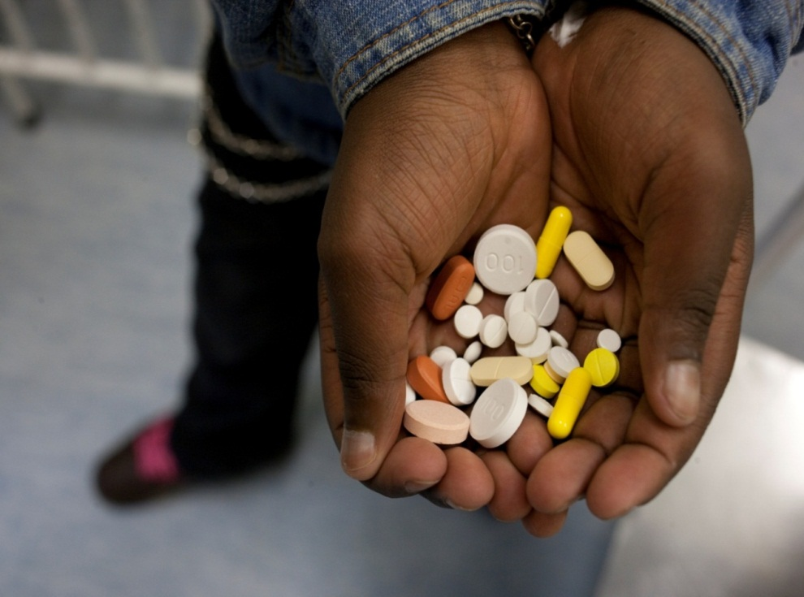
MDR-TB treatment
Notes:
MDR-Tb drugs plus ARVS

Slide 8
MDR-TB treatment in children (n=149)
Management |  | n (%)
Admitted to hospital | Yes | 103 (69.1)
Median duration admission (mo; n=103) |  | 5 (3-7)
Treated with injectable drugs (n=142) | Yes | 94 (66.2)
Median duration of injectable drug use (n=94;IQR) |  | 4 (4-6)
Median duration of total treatment (n=137 ;IQR) |  | 13 (11-18)
Median number of months to culture conversion (n=40) |  | 1 (0.5-2)
Seddon, Clin Infect Dis 2013

Slide 9
Treatment outcomes in children with MDR-TB
Outcome | N = 149 (%)
Cure | 36 (24.2)
Probable cure* | 101 (67.8)
Transferred out | 1 (0.7)
Lost to follow up | 8 (5.4)
Died | 3 (2.0)
Includes 8 patients who stopped their therapy before indicated but were clinically well at follow up
Seddon, Clin Infect Dis 2013

Slide 10
Adverse events (n = 137)
Grade of AE | Gr 0 | Gr 1 | Gr 2 | Gr 3-4 | Any AE (%)
Joint, muscle or bone pain | 122 | 11 | 2 | 2 (1.5) | 15 (10.9)
Skin rashes | 104 | 30 | 2 | 1 (0.7) | 33 (24.1)
Itchy skin | 110 | 24 | 2 | 1 (0.7) | 27 (19.7)
Headache | 120 | 16 | 1 | 0 | 17 (12.4)
Sleep/mood problem | 124 | 9 | 3 | 1 (0.7) | 13 (9.5)
Lethargy | 118 | 17 | 1 | 1 (0.7) | 19 (13.9)
Visual problem | 132 | 5 | 0 | 0 | 5 (3.6)
Vomiting | 113 | 20 | 3 | 1 (0.7) | 24 (17.5)
Diarrhoea | 125 | 10 | 1 | 1 (0.7) | 12 (8.8)
Jaundice | 133 | 1 | 2 | 1 (0.7) | 4 (2.9)
↓Appetite/nausea | 118 | 14 | 3 | 1 (0.7) | 18 (13.1)
Hearing loss (n=142) |  |  |  |  | 25 (17.6)
Thyroxine supplementation (n=142; ↑TSH & ↓ fT4) |  |  |  |  | 32 (22.5)
Seddon, Clin Infect Dis 2013

Slide 11
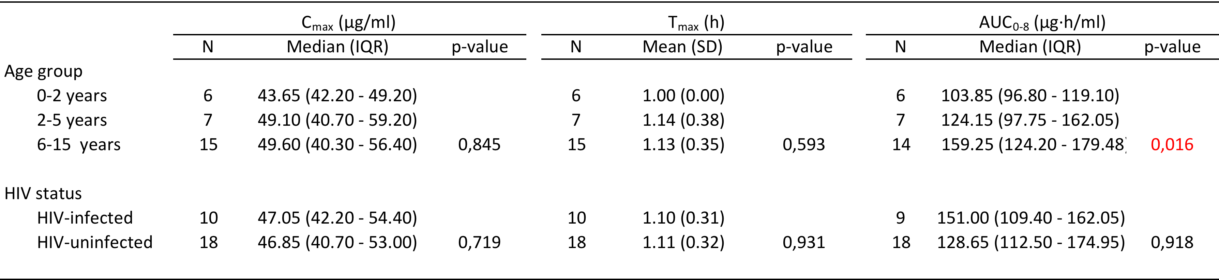
AMIKACIN PK BY AGE AND HIV STATUS (N=28)
Adult target values:
C_{max}: 35-45 ug/ml

Slide 12
Levofloxacin for children: 15 mg/kg daily
Parameter | Median (IQR) PK value (n=23)
C_{max} (μg/ml) | 6.71 (4.69 - 8.06)
AUC₀₋₈ (μg∙h/ml) | 29.89 (23.81 - 36.39)
Parameter | Target value | Mean (sd) PK value/MIC if MIC is 0.5 | Mean (sd) PK value/MIC if MIC is 1.0
C_{max} /MIC | 8-10 | 13.1 (4.0) | 6.5 (2.0)
AUC/MIC | 100 | 65.3 (18.4) | 32.6 (9.2)
Thee, Antimicrob Agents Chemother, 2013
Notes:
Intensive PK sampling from t0 through 8 hours
Exact mg/kg levo dose given – 15 mg/kg, administered by study team

Slide 13
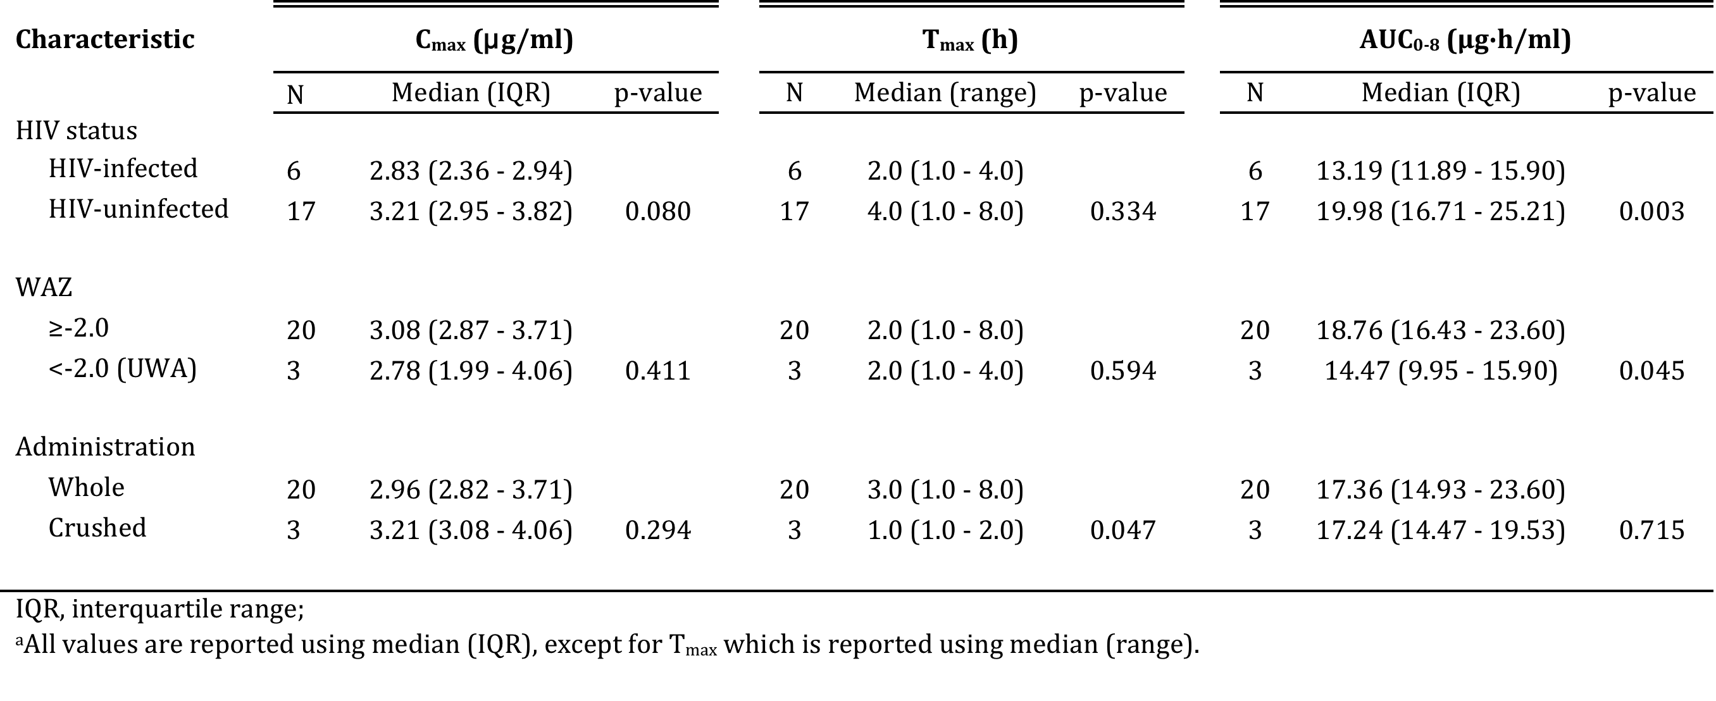
Moxifloxacin PK in children by HIV status, nutritional status and administration method: 7-15 years, n=23
Mean AUC₀₋₂₄/MIC: 56.1 Target: 100
Mean Cmax/MIC: 6.5: target: 8-10
Thee, in press
Notes:
Multivariate model: influence of HIV reproducible but not of malnutrition

Slide 14
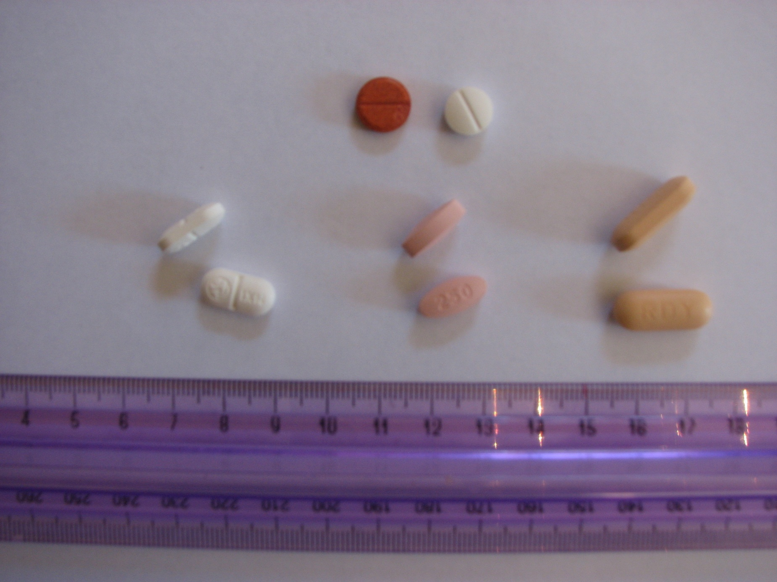
Ofloxacin
200 mg
Levofloxacin
250 mg
Moxifloxacin
400 mg

Slide 15

DELAMANID
Trial 232: Phase 1 PK Age De-escalation study
  Define dose of delamanid in children resulting in AUC comparable to the effective AUC observed in adult MDR-TB trials
Trial 233: Phase 2 Safety Study
  Investigate the safety, tolerability, and PK of delamanid administered for six months in a pediatric population receiving concomitant OBR
  Enrolling: Philippines, South Africa

Slide 16
Group 1: Adolescents 12 to 17 years
  (100 mg BID, n=6)
Group 2: Children 6 to 11 years
  (50 mg BID; n=6)
Pediatric formulation
Group 3: Children 3 to 5 years
  (25 mg BID; n=6) and (50 mg BID; n=6)
Group 4: Newborns and infants 0 to 2 years
  (5 mg BID; n=6) and (25 mg BID; n =6)
  IMPAACT: HIV co-infection study planned
  N= 36 HIV+ children: DDI, PK and safety; PK modeling

Slide 17
Delamanid Pediatric Development Timeline
2011 2012 2013 2014 2015 2016 2017
Chemistry
&
Manufact-uring
Pediatric Formulation Development
2011- 2013
Pre-
clinical
Juvenile Rat Study
2011 -2012
BE study
2014
Clinical
PK/Safety
Patients 12-17y
PK/Safety
Patients 6-11y
PK/Safety
Patients 3-5y
PK/Safety
Patients 0-2y
Long Term Safety
Patients 0-17y
2013 - 2017
Notes:
17

Slide 18
Bedaquiline
Paediatric PK and safety study planned
Confirmed and probable MDR-TB
Age de-escalation, 4 age cohorts
Sites in Peru, Russia, South Africa
HIV-uninfected children only (n=60)
Janssen, TB Alliance

Slide 19
Novel MDR-TB treatment regimen
Injectable sparing shorter regimen (STREAM)
Smear negative TB
Optimizing safe and effective SLD: FQN, PK and modeling
Role of clofazamine, PAS, Linezolid
Adult PK targets
Inclusion of novel drugs: DMD, BDQ, others
9 months
Multicentre trial, non-inferiority

Slide 20
STAND: PA -824, M, Z
Adolescent inclusion planned: phase 3
DS, DR-TB

Slide 21
NiX-TB: XDR-TB
Randomized, open-label trial assessing bedaquiline plus PA-824 plus linezolid plus pyrazinamide or bedaquiline plus PA-824 plus linezolid in subjects with pulmonary infection with XDR-TB
TB Alliance
J-L-Pa--Z
Including adolescents (>14 years)

Slide 22
TB CHAMP
Is levofloxacin (LFX), given daily for 6 months, effective to prevent MDR-TB in high-risk child and adolescent household contacts of MDR-TB cases?
Does LFX have acceptable toxicity and tolerability in children?
Is there a difference in mortality between study arms?
Is adherence similar between study arms?
Are there differences in LFX resistance between study arms for children developing incident TB?
Is LFX cost-effective and acceptable to prevent MDR-TB in child and adolescent HHC?

Slide 23
Design
Community-based, multicentre, cluster randomised phase III superiority trial of LFX vs. placebo
Prevention of MDR-TB in HIV-infected and uninfected child household contacts of confirmed MDR-TB N=1680; children 0-5 years
Primary outcome: incident TB disease by 12 months post-randomisation
South African sites
Funded: BMRC/Wellcome Trust, SA MRC
In partnership with BMRC CTU

Slide 24
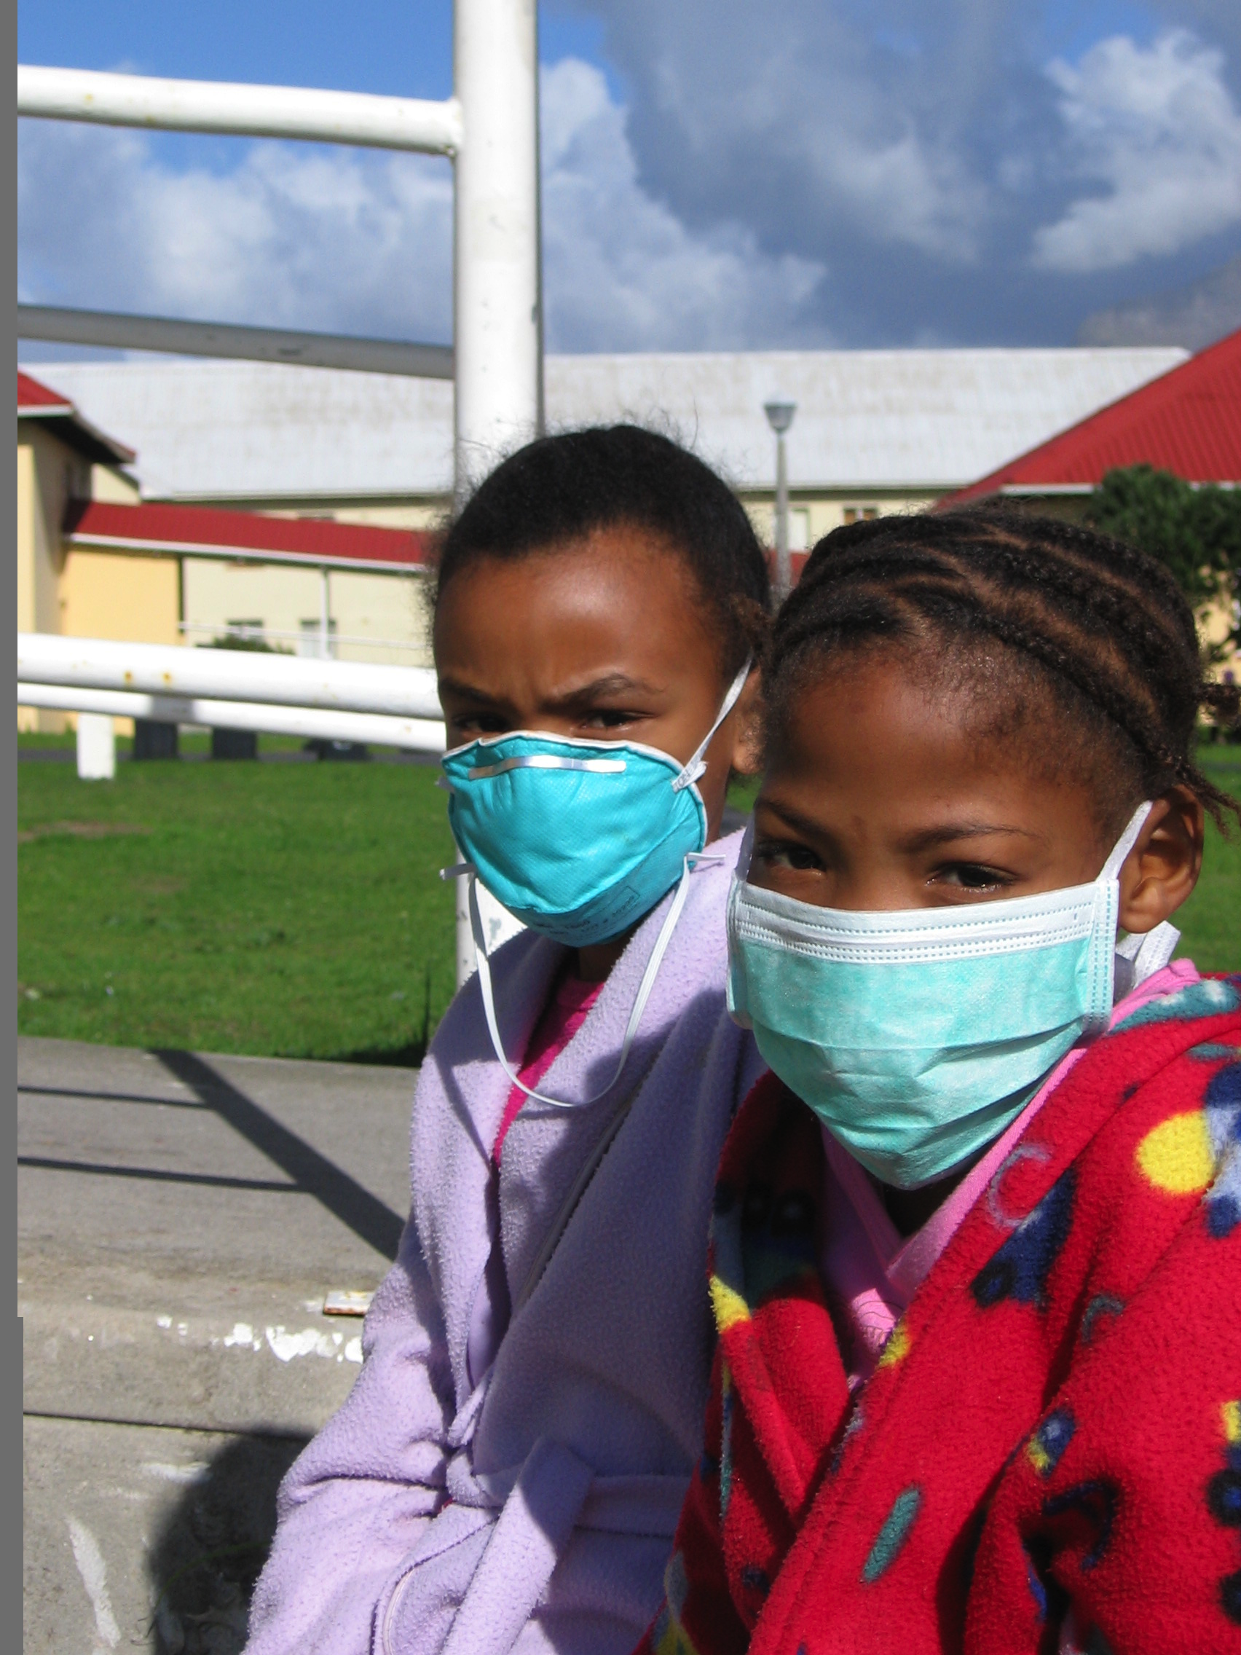

Slide 25




ACKNOWLEDGEMENTS
Simon Schaaf
Tony Garcia-Prats
Heather Draper
Helen McIlleron
Jennifer Norman
Lubbe Wiesner
Peter Smith
Marianne Willemse
Peter Donald
James Seddon
Kelly Dooley
Andre Burger
Brewelskloof Hospital paediatric team
Study participants and their parents/care-givers!

